Slide 1
PRESENTATION - 1

Slide 2
FINAL REPORT OF A TRIAL OF INTENSIVE VS STANDARD BLOOD PRESSURE CONTROL
The NEW ENGLAND JOURNAL of MEDICINE
N Engl J Med 2021;384:1921-30.
Dr Karthik. A
Post graduate Student
Dept of Medicine, PGIMS Rohtak

Slide 3
REWIND

Slide 5
INTRODUCTION
Hypertension is highly prevalent in the adult population, especially among persons older than 50 yrs of age.
Isolated SYSTOLIC HYPERTENSION is the MOST common form of hypertension

Slide 6
INTRODUCTION
Systolic Blood Pressure is MORE important than Diastolic Blood Pressure as an independent RISK PREDICTOR for
Coronary events , stroke, and ESRD.
Treatment of hypertension reduces the risk of cardiovascular disease outcomes, including incident
Stroke (by 35 to 40%), MI (by 15 to 25%), and HF (by up to 64%).

Slide 7
METHODS
SPRINT TRIAL
(Systolic Blood Pressure Intervention Trial)
Sponsored By
National Institute of Diabetes and Digestive and Kidney Diseases.
National Institute of Neurological Disorders and Stroke.
National Institute of Aging
Randomized
Controlled
Open labelled

Slide 8
Inclusion CRITERIA
Increased cardiovascular risk was defined by one or more of the following: clinical or subclinical cardiovascular disease other than stroke;
CKD (excluding PCKD), with eGFR of 20-60 ml/min/1.73 m2 of BSA, or
A 10-year risk of cardiovascular disease of 15% or greater on the basis of the Framingham risk score; or
An age of 75 years or older.
Age of at least 50 years,
Systolic blood pressure of 130 to 180 mm Hg
An increased risk of cardiovascular events

Slide 9
exclusion CRITERIA
CV event or procedure or hospitalization for unstable angina within last 3 months .
Symptomatic HF within the past 6 months or LVEF< 35%.
Known secondary cause of hypertension.
One minute standing SBP < 110 mm Hg.
DM
History of stroke.
PCKD.
Treated Glomerlonephritis.
eGFR < 20 ml/min /1.73m2
or end-stage renal disease (ESRD).

Slide 10
14,692 Patients assessed for Eligibility
5331 WERE INELIGIBLE OR DECLINED TO PARTICIPATE
9361 Underwent Randomization.
4678
INTENSIVE GROUP
4683
STANDARD GROUP
224 - DISCONTINUED INTERVENTION - 242
111 - WERE LOST TO FOLLOW UP - 134
154 - WITHDREW CONSENT - 121

Slide 11
ELIGIBLE PATIENTS
4678
INTENSIVE TREATMENT GROUP
(SBP : <120mmHg)
4683
STANDARD TREATMENT GROUP
(SBP : <140mmHg)
All Major classes of Anti hypertensives were included in the formulary and were provided at no cost to participants.
Monthly Follow-up x 3 MONTHS
TARGET BP
< 120mmHg
TARGET BP
135 – 139mmHg
3 Monthly Follow-up

Slide 12
TERMINOLOGIES

Slide 13
SERIOUS ADVERSE EVENTS
EVENTS
Fatal or life threatening
Prolonged Hospitalization
Clinically significant or persistent disability
Clinically significant hazard or harm to the participant

Slide 14
OUTCOMES
The FIRST OCCURRENCE of
MI
ACS
CHF
STROKE
FOR PATIENTS WITH CKD AT
BASELINE
(eGFR <60mL/min/1.73m2)
<50% reduction in eGFR
ESRD requiring dialysis
RRT
FOR PATIENTS ITH NO CKD AT BASELINE
Decrease in eGFR >30%
Included the INDIVIDUAL COMPONENTS of the primary composite outcome,
death from any cause,
and the composite of the primary outcome or death from any cause.
PRIMARY OUTCOME
SECONDARY OUTCOME
RENAL OUTCOME

Slide 15
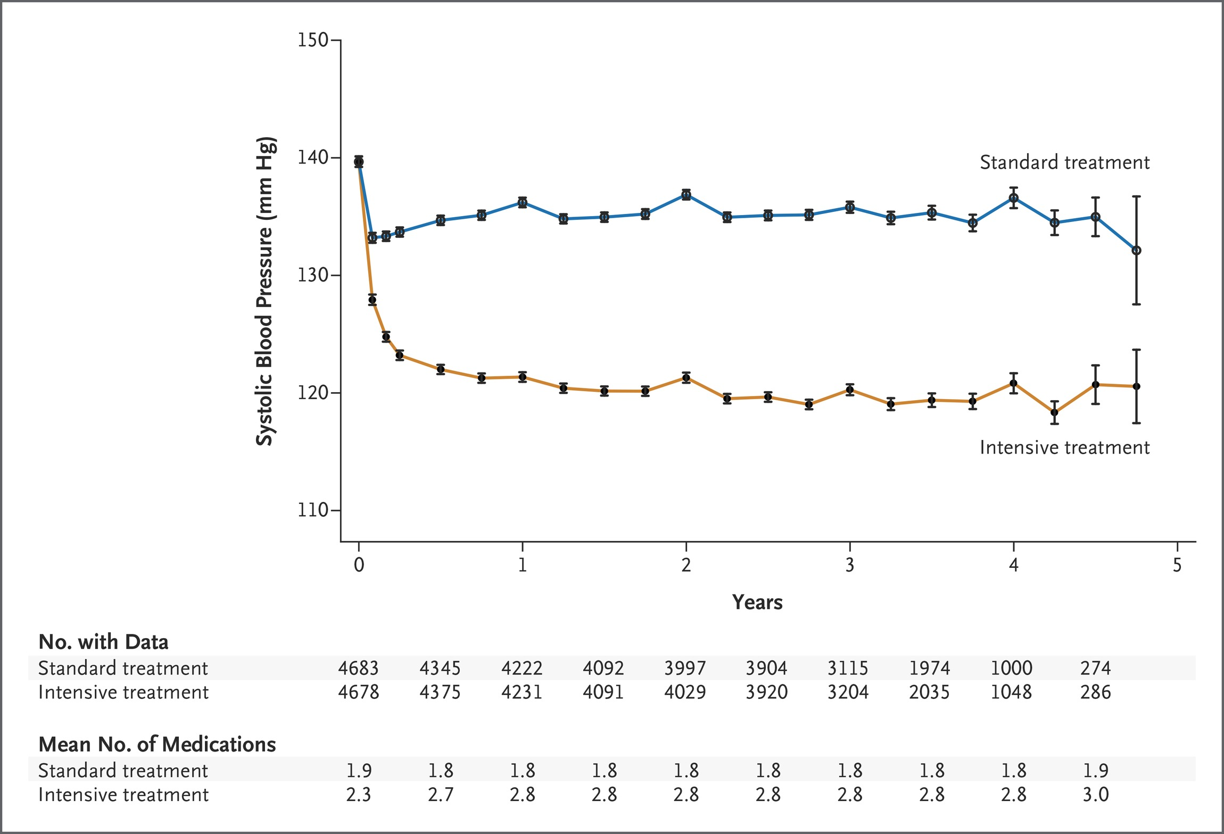
Systolic Blood Pressure In The Two treatment groups over the Course of trial

Slide 16
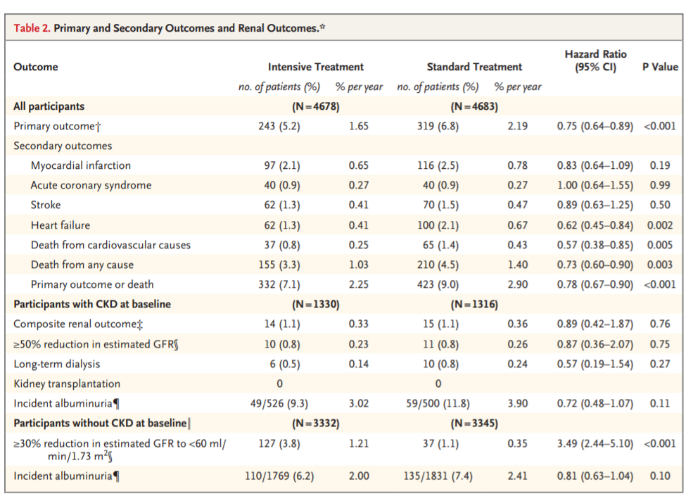

Slide 17
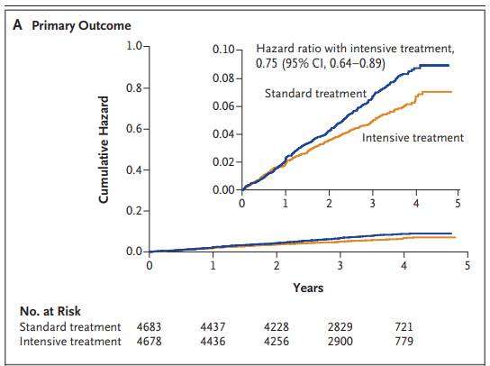
PRIMARY OUTCOME

Slide 18
SECONDARY OUTCOME

Slide 19
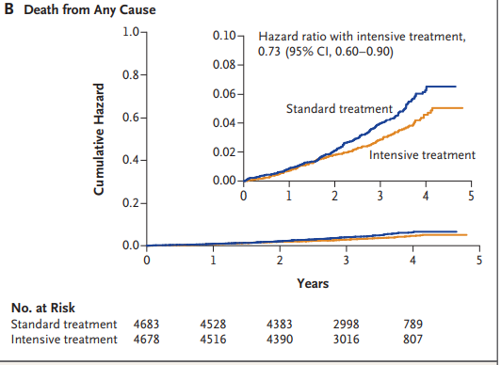
DEATH FROM ANY CAUSE

Slide 20
RENAL OUTCOME

Slide 21
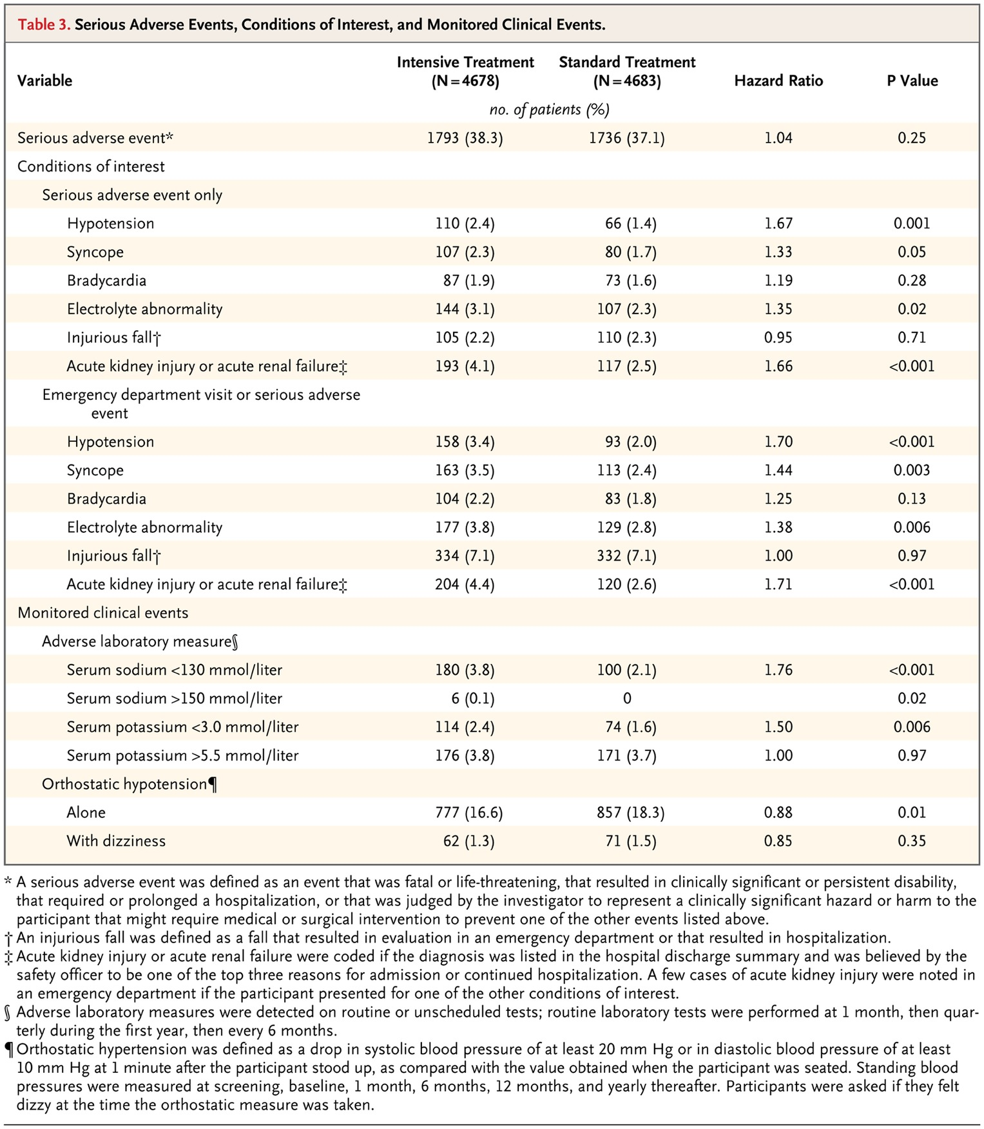
A
D
V
E
R
S
E
E
V
E
N
T
S

Slide 22
CONCLUSION OF THE SPRINT TRIAL
Targeting a systolic blood pressure of less than 120 mm hg, as compared with less than 140 mm hg, in patients at high risk for cardiovascular events but without diabetes resulted in lower rates of fatal and nonfatal major cardiovascular events and death from any cause. However, some adverse events occurred significantly more frequently with the lower target

Slide 23
Because of the marked advantages that were seen in the INTENSIVE TREATMENT group
TRIAL WAS STOPPED PREMATURELY
(5yrs → 3yrs)

Slide 24
PITFALLS OF PREMATURELY STOPPING THE STUDY
Investigators had not yet been able to adjudicate all potential outcome events that occurred during the intervention period because the study had stopped early.
Investigators had not yet collected data or analyzed data after the intervention period ended.

Slide 25
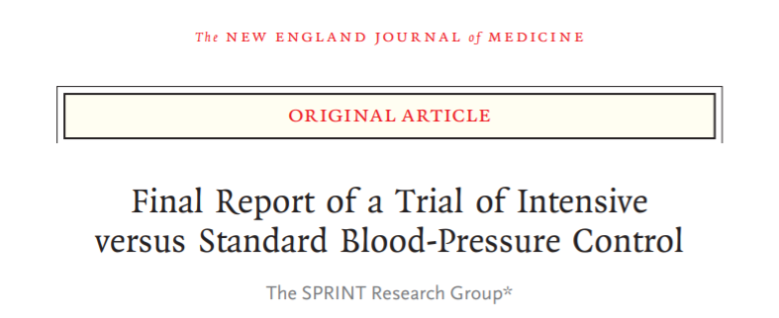
N ENGL J MED 384;20
MAY 20,2021

Slide 26
WHAT’S NEW ?
Contains the full results encompassing all adjudicated outcomes during the intervention period, as well as events occurring in the Post – intervention period stretching from August 2015 – July 2016

Slide 27
METHODS - NEW
SPRINT TRIAL
Sponsored By
National Institute of Diabetes and Digestive and Kidney Diseases.
National Institute of Neurological Disorders and Stroke.
National Institute of Aging
Randomized
Controlled
Open labelled
POST TRIAL FOLLOW-UP

Slide 28
CLINICAL OUTCOMES: INTERVENTIONAL STAGE

Slide 29
PRIMARY OUTCOMES BETWEEN THE TWO STUDIES WERE SIMILAR DURING THE INTERVENTIONAL PERIOD.
ALL-CAUSE MORTALITY WAS SIMILAR TO THE PREVIOUSLY PUBLISHED FINDINGS
RATES OF SECONDARY OUTCOMES WERE SIGNIFICANTLY LOWER IN THE INTENSIVE- TREATMENT GROUP.
NO DIFFERENCE IN RATES WERE NOTED BETWEEN THE TWO STUDIES AS FAR AS RENAL OUTCOMES WERE CONCERNED.
INTENSIVE
STANDARD
INTENSIVE
STANDARD
PRIMARY OUTCOME
1.65%/yr
2.19%/yr
1.77%/yr
2.40%/yr
All cause mortality
1.40%/yr
1.41%/yr
1.03%/yr
1.06%/yr
Pts with baseline CKD
0.33%/yr
0.36%/yr
0.39%/yr
0.37%/yr
Pts with NO baseline CKD
1.21%/yr
0.35%/yr
1.39%/yr
0.38%/yr
29

Slide 30
CLINICAL OUTCOMES
POST-INTERVENTIONAL STAGE

Slide 31
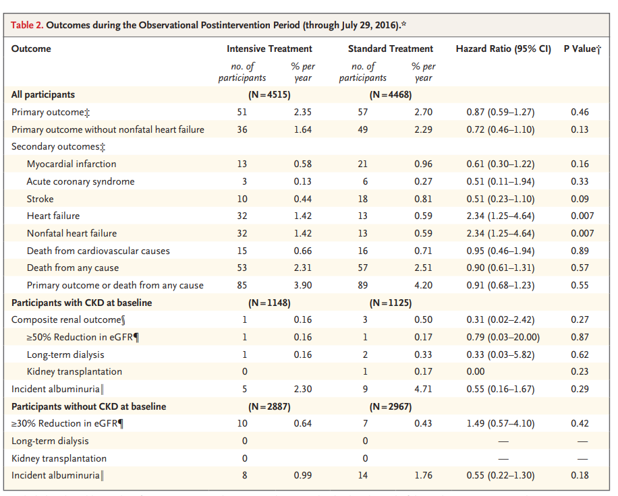

Slide 32
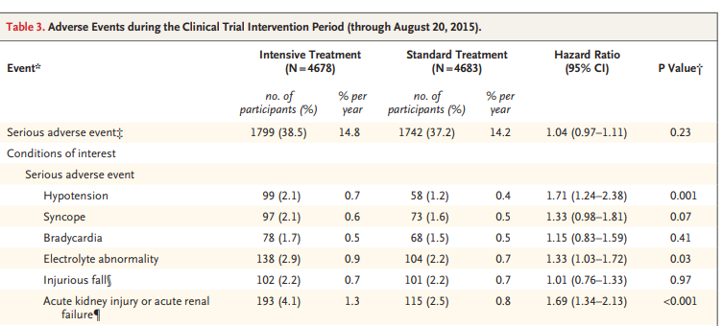

Slide 33
STUDY
RESULTS

Slide 34
PRIMARY OUTCOME
INT. GROUP < STD GROUP
DEATH RATES incl.
CVS causes.
INT. GROUP < STD GROUP
MI RATE
INT. GROUP < STD GROUP

Slide 35
RATES OF HEART FAILURE
STD GROUP ||| INT. GROUP
Renal outcomes
Baseline CKD pts
STD GROUP ||| INT. GROUP
SERIOUS ADVERSE EVENTS
INT. GROUP > STD GROUP

Slide 36
ADHF
INT. GROUP > STD GROUP
USE OF ANTI-HYPERTENSIVES IN INTENSIVE GROUP.
INTENSITY OF BP TREATMENT IN INT. GROUP.

Slide 37
THE
CONCLUSION

Slide 38
INTENSIVE TREATMENT TO REDUCE BP
FATAL CV EVENTS
DEATH FROM ANY CAUSE
SERIOUS ADVERSE EVENTS
BENEFIT
RISK

Slide 39
THE LOWER IS BETTER

Slide 40
YOU
THANK

